Slide 1
Networking with LOGO! 0BA7
Networking in Master/Slave mode

Slide 2
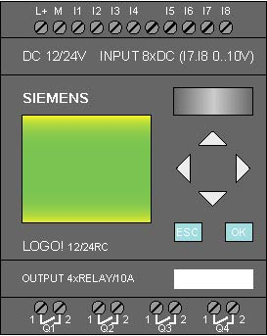
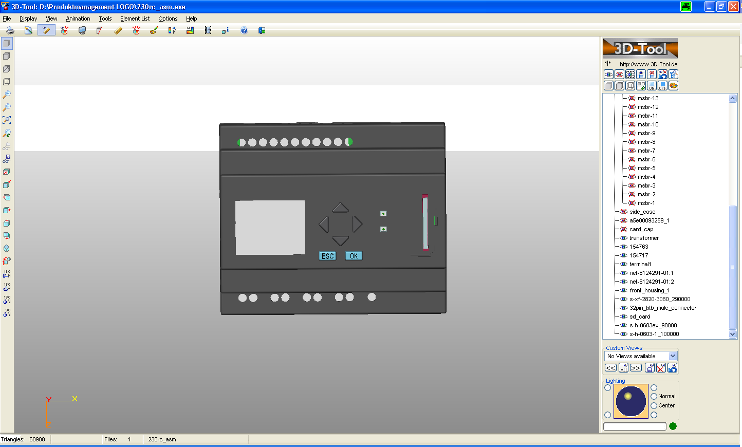


Networking with LOGO! 0BA7 in Master/Slave mode
Master
Slave
E
E
E
E
All LOGO! 0BA7 Slaves acts as a
IO expansion unit.
Only the LOGO! Master contains
a program

Slide 3
Networking with LOGO! 0BA7 in Master/Slave mode
E
E
LOGO! 0BA7
8 + 1 connections supported
max. 1 Master and 8 Slaves
(1 reserved for LOGO! Soft Comfort V7)
Max. expansion:
64 Slave Inputs, 64 Slave Outputs, 32 Slave AI, 16 Slave AQ
At the same time data exchange from/to
+ LOGO! Slave (Remote IO)
+ LOGO! Master
+ Siemens HMI
+ SIMATIC Controller
+ PG/PC via OPC
is possible

Slide 4
Networking with LOGO! 0BA7 in Master/Slave mode
Master
E
E
LOGO! 0BA7
Only the master contains a
program
all slaves only requires
+ slave mode setting
+ Slave IP
+ Master IP
Slaves incl. EM’s supported
Max. 8
E
E
E
E
Slave
Slave

Slide 5
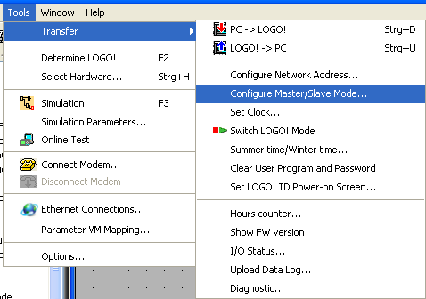
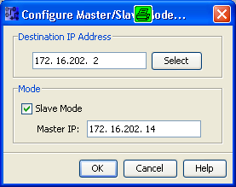




Networking with LOGO! 0BA7 in Master/Slave mode
Configure Slave mode via
LOGO! Soft Comfort V7
Configure Slave mode on
LOGO! 0BA7 base module
If you change to Slave mode, then an existing program in this LOGO! 0BA7 will be deleted!
Be sure to have the correct Ethernet addressing:
IP-Address individual
same Subnet mask
same Gateway address
Mac-Address individual

Slide 6
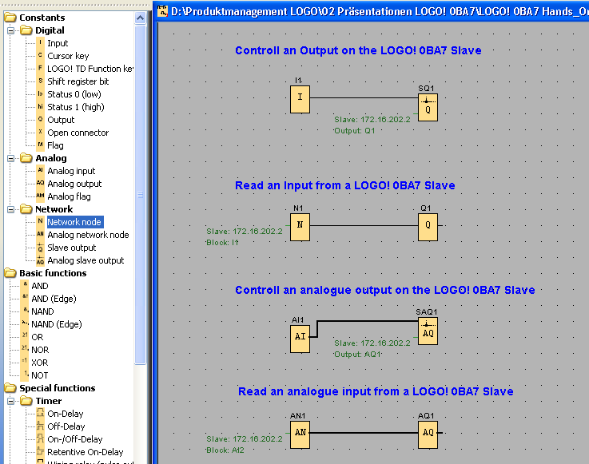
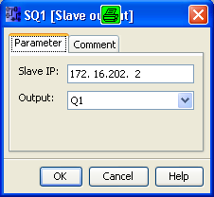
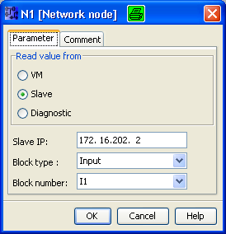
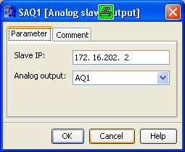
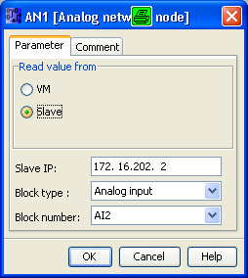
Networking with LOGO! 0BA7 in Master/Slave mode
If you add a network node, then the client connection will
be configured automatically

Slide 7
Networking wiht LOGO! 0BA7 V1
Thank you for your attention!
H. Schindler
I IA AS FA PS4
Phone: ++49 (0)911 / 895 - 3665
E-Mail: Helmut.schindler@siemens.com

